Slide 1
Loss Prevention for Managers
Essential Skills
Kyle Kaufman
Notes:
This module of learning will focus on the essential skills Store Managers need to be proficient in to run a store safely and effectively. This training will address learning gaps in the Essential Skills module. The primary objective of the Loss Prevention training program for Managers is to educate them on their responsibilities, enabling them to identify key aspects of their role to ensure store safety and minimize theft and risk. This program will be delivered via an LMS and will be asynchronous, allowing learners to work through the course in their own time.

Slide 2
Learning Objectives for this course:
Develop and implement effective strategies to identify risks
Understand the legal implications of Loss Prevention activities, including the rights of employees and customers
Train and mentor store staff on Loss Prevention techniques and policies
Understand how to maintain accurate and detailed records of Loss Prevention activities and incidents
Notes:
By incorporating these strategies into the learning process, learners gain a comprehensive understanding of loss prevention, from theoretical knowledge to practical application. This approach ensures they are well-equipped to handle real-world challenges effectively and ethically.
Develop and Implement Effective Strategies to Identify Risks:
Proactive Learning: By focusing on risk identification and mitigation, learners are encouraged to think ahead and anticipate potential issues. This proactive approach fosters critical thinking and problem-solving skills.
Real-World Application: Implementing these strategies in real scenarios helps learners understand the practical implications of their actions, making the learning experience more tangible and relevant.
Understand the Legal Implications of Loss Prevention Activities, Including the Rights of Employees and Customers:
Ethical Awareness: Learning about legal implications ensures that learners are aware of the ethical and legal boundaries within which they must operate. This promotes responsible and lawful behavior.
Informed Decision-Making: Understanding legal aspects helps learners make informed decisions that comply with regulations, reducing the risk of legal issues and enhancing their professional competence.
Train and Mentor Store Staff on Loss Prevention Techniques and Policies:
Skill Development: Training and mentoring provide hands-on experience, allowing learners to practice and refine their skills in a supportive environment.
Engagement and Retention: Interactive training sessions and mentorship programs keep learners engaged and motivated, leading to better retention of information and techniques.
Understand How to Maintain Accurate and Detailed Records of Loss Prevention Activities and Incidents:
Attention to Detail: Maintaining accurate records requires meticulous attention to detail, which is a valuable skill in any professional setting. This practice helps learners develop precision and thoroughness.
Accountability and Transparency: Accurate record-keeping promotes accountability and transparency, ensuring that all activities and incidents are documented properly.

Slide 3
Overall Program Flow
Introduction
CBT/Activity: Identifying Scams
QRG: Most Common Scams
CBT/Activity: Communicating with Law Enforcement
QRG: How to Respond if an Officer Requests a Video
CBT: End of Day Procedures and Best Practices
QRG: EOD Checklist
Final Assessment
Notes:
This course is designed to be completed sequentially in its entirety. However, it features an open-ended time limit, allowing Store Managers to complete it at their own pace. As learners complete each item, they will progress through the training. The module includes texts introducing various topics, videos when applicable, and interactive assessments tailored to the topic.
The course opens with an Introduction page, showing the order of learning items. Then, it continues with interactive Computer-Based Training (CBTs), supplemented by Quick Reference Guides (QRGs). These QRGs provide detailed information on the topics covered in the CBTs. Both the CBTs and QRGs will remain accessible to learners even after completing the program, serving as valuable resources for future reference. Learners can track their progress throughout the course, seeing what items are next, the duration of each item, and how much of the course remains to be completed.
Estimated duration: 3 days

Slide 4
Introduction Page
Show the flow and order of the learning module
Show estimated time of completion
Show learning objectives
Notes:
The Introduction Page will have easy-to-access navigation of the course. It will show the items of the course in sequential order, with the time duration of each item. Each item will give a brief description of the course and outline each course’s learning objectives.

Slide 5
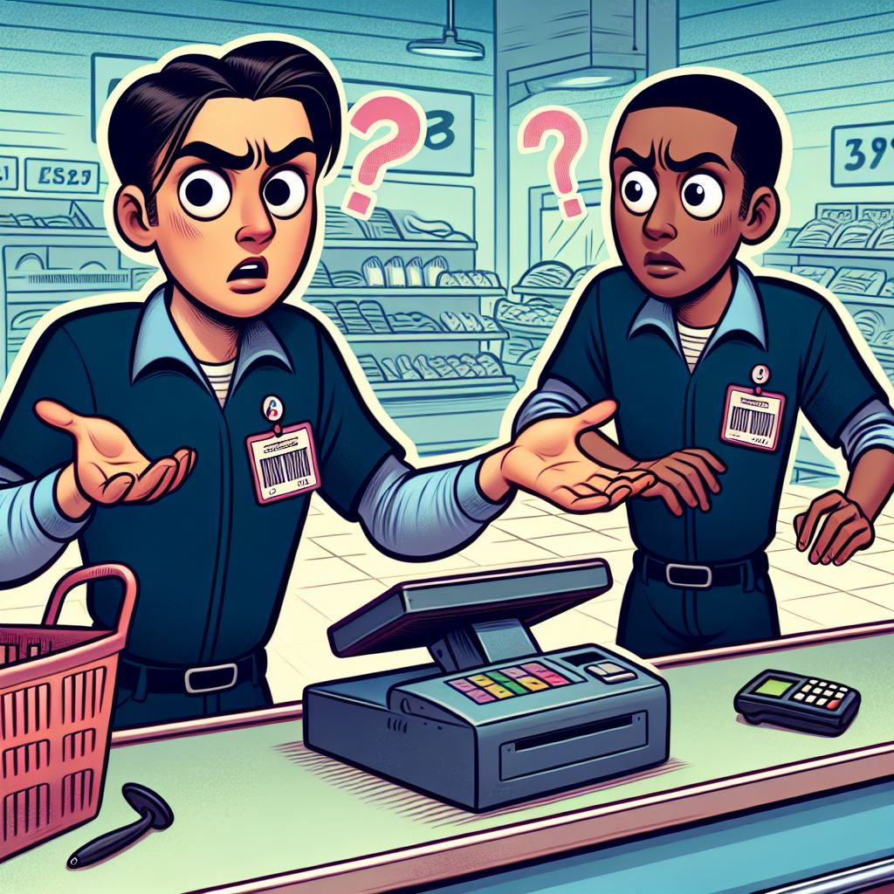
CBT/Activity Identifying Scams
This CBT will cover:
The four most common scams used in stores.
How to identify scams
Best practices to combat scams
An interactive way to practice skills learned
Notes:
This CBT module will utilize engaging and colorful animations to illustrate different scam scenarios. A professional narrator will guide viewers through each scenario, providing clear and concise explanations of the scams as they are presented. The video, designed to be both informative and visually appealing, will have a duration of 2-3 minutes, keeping information direct and to the point (following the Coherence Principle). They will focus on the following four major scams seen mostly in the business:
Quick Change Scams: Demonstrating how scammers confuse cashiers to receive more change than they are due.
Phone Scams: Highlighting tactics used by scammers to deceive individuals over the phone, often to extract personal information or money.
Counterfeit Cash: Showing how counterfeit bills are used and the methods to identify them.
Cash Card Scams: Explaining how scammers use stolen or fake cash cards to make fraudulent purchases.
By incorporating these elements, the CBT aims to educate viewers on recognizing and preventing these common scams, ultimately enhancing their awareness and preparedness.
This CBT will adhere to the Modality principle by utilizing vibrant graphics and images throughout the course, without displaying text on the screen. However, there will be an option for subtitles to accommodate individuals who are deaf or non-English speakers.

Slide 6
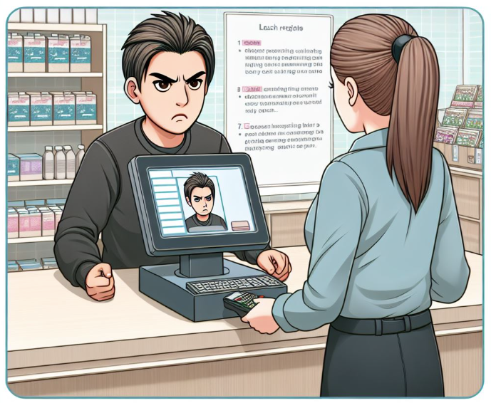


Identifying Scams: Interactive Practice
Scenario #1: A customer approaches the cashier with a friendly demeanor and asks to change a $50 bill into smaller denominations. After the cashier hands over the smaller bills, the customer quickly changes their mind and asks for different denominations, repeatedly switching back and forth. The customer tries to confuse the cashier by talking rapidly and creating a sense of urgency.
Scenario #2: A customer, who is very nice and energetic, approaches the cashier to make a purchase. They hand over a $100 bill with a big smile and engage in friendly conversation to distract the cashier. The cashier notices something unusual about the bill but is unsure if it's counterfeit.
Scenario #3: A customer enters the store and starts browsing. They seem nervous and keep looking around as if checking if they are being watched. When they approach the cashier, they make a small purchase but act jittery and avoid eye contact. The customer hands over a large bill for a small purchase, which raises suspicion.
Notes:
This activity will present learners with three scenarios, each designed to help them discover how to handle different situations effectively. For each scenario, learners will be given a series of choices, with each choice representing a different level of response:
Best Answer: Worth 5 points
Okay Answer: Worth 3 points
Bad Answer: Worth 1 point
Terrible Answer: Worth 0 points
Each choice will include an explanation of why it is or isn't an acceptable response. This approach provides immediate feedback with corrections when necessary and uses realistic scenarios. This adds engagement and encourages active learning.
Since there are only three scenarios when the training prior covered the four major scams, this adds a level of challenge to the activity by having learners think back to the four major scams they learned and deciding what scam is happening.

Slide 7
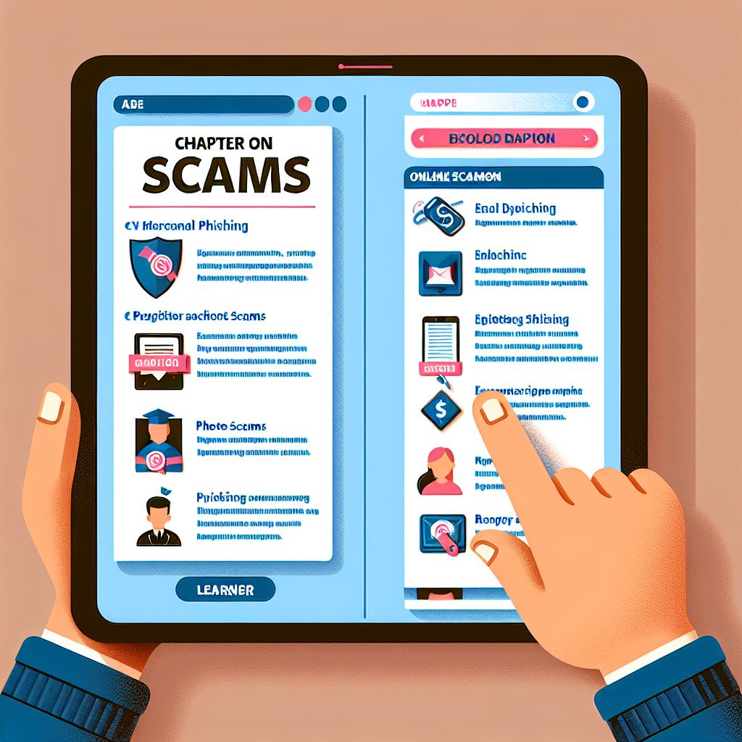
QRG: Most Common Scams
Introduction:
Importance of recognizing and preventing scams in retail.
Scam Descriptions:
Detailed descriptions of various scams with video examples.
Accessibility:
Available via smartphone or store tablet.
Content Structure:
Scam Title, Description, Video Example of scam, and Helpful Tips
Notes:
Introduction:
Brief overview of the importance of recognizing and preventing scams in retail.
Scam Descriptions:
Detailed descriptions of various scams, including but not limited to:
Quick Change Scams
Phone Scams
Counterfeit Cash
Cash Card Scams
Return Fraud
Sweethearting
Price Tag Switching
Gift Card Fraud
Shoplifting Techniques
Online Order Scams
Page Layout:
Scam Title: Clearly labeled at the top of each page.
Description: In-depth explanation of how the scam works and its impact on the store.
Video Example: Embedded video demonstrating the scam in action.
Helpful Tips: Practical tips and strategies for identifying and preventing the scam.
Accessibility:
The QRG will be available in a digital format, accessible via smartphone or store tablet. Designed to be user-friendly, with easy navigation between chapters and pages.
Purpose:
To educate employees on the various scams they may encounter.
To provide practical tools and tips for preventing and addressing scams.
To enhance overall loss prevention efforts within the store.

Slide 8

Final Assessment Overview
Coverage: 20 questions on material from all CBTs and QRGs
Question Types: Multiple Choice, Matching, True/False
Review Access: Material available for review
Feedback: Provided for incorrect answers to enhance understanding
Pass Rate: 80%
Notes:
Final Assessment Overview:
The final assessment will consist of 20 questions designed to evaluate the learner's understanding of the material covered in all CBTs, QRGs, and interactive activities. The assessment will encourage learners to reflect on the material and apply their knowledge to answer the questions.
The assessment will feature a variety of question types to test different aspects of the learner's knowledge and skills:
Multiple Choice: Questions that provide several answer options, with only one correct answer.
Matching: Questions that require learners to match related items, such as terms and definitions.
True/False: Statements that learners must identify as either true or false.
Learners will have access to the course material for review during the assessment. This enables them to refer back to the content if needed, promoting a deeper understanding rather than just memorization.
For each incorrect answer, learners will receive immediate feedback explaining why the answer is incorrect and providing guidance on the correct concept. This feedback aims to help learners understand the underlying principles and improve their comprehension. The feedback will be constructive and educational, encouraging learners to think critically about the material and reinforcing their learning.
Assessment Goals:
The main goal of the final assessment is to ensure that learners have a solid grasp of the key concepts and can apply them in real-world scenarios. The assessment is designed to be a learning tool in itself, helping learners identify areas where they may need further study and reinforcing their overall understanding of the course content.
Scoring and Passing Criteria:
Each question will be scored, and learners must achieve a minimum of 80% passing score to demonstrate their proficiency. The scoring system will be transparent, and learners will be informed of the passing criteria before starting the assessment.

