Slide 1
Species Connections in Eelgrass Ecosystems
Nearshore Ecosystems and Eelgrass: Lesson 1B

Slide 2
Overarching Question
How does Eelgrass affect the severity of ocean acidification within eelgrass beds?
What have we
learned so far?

Slide 3
Learning Objectives
01
02
Students can describe species in eelgrass ecosystems and discuss their basic interactions.
Students can describe how these species interactions may change with altered oceanic conditions (due to ocean acidification).

Slide 4
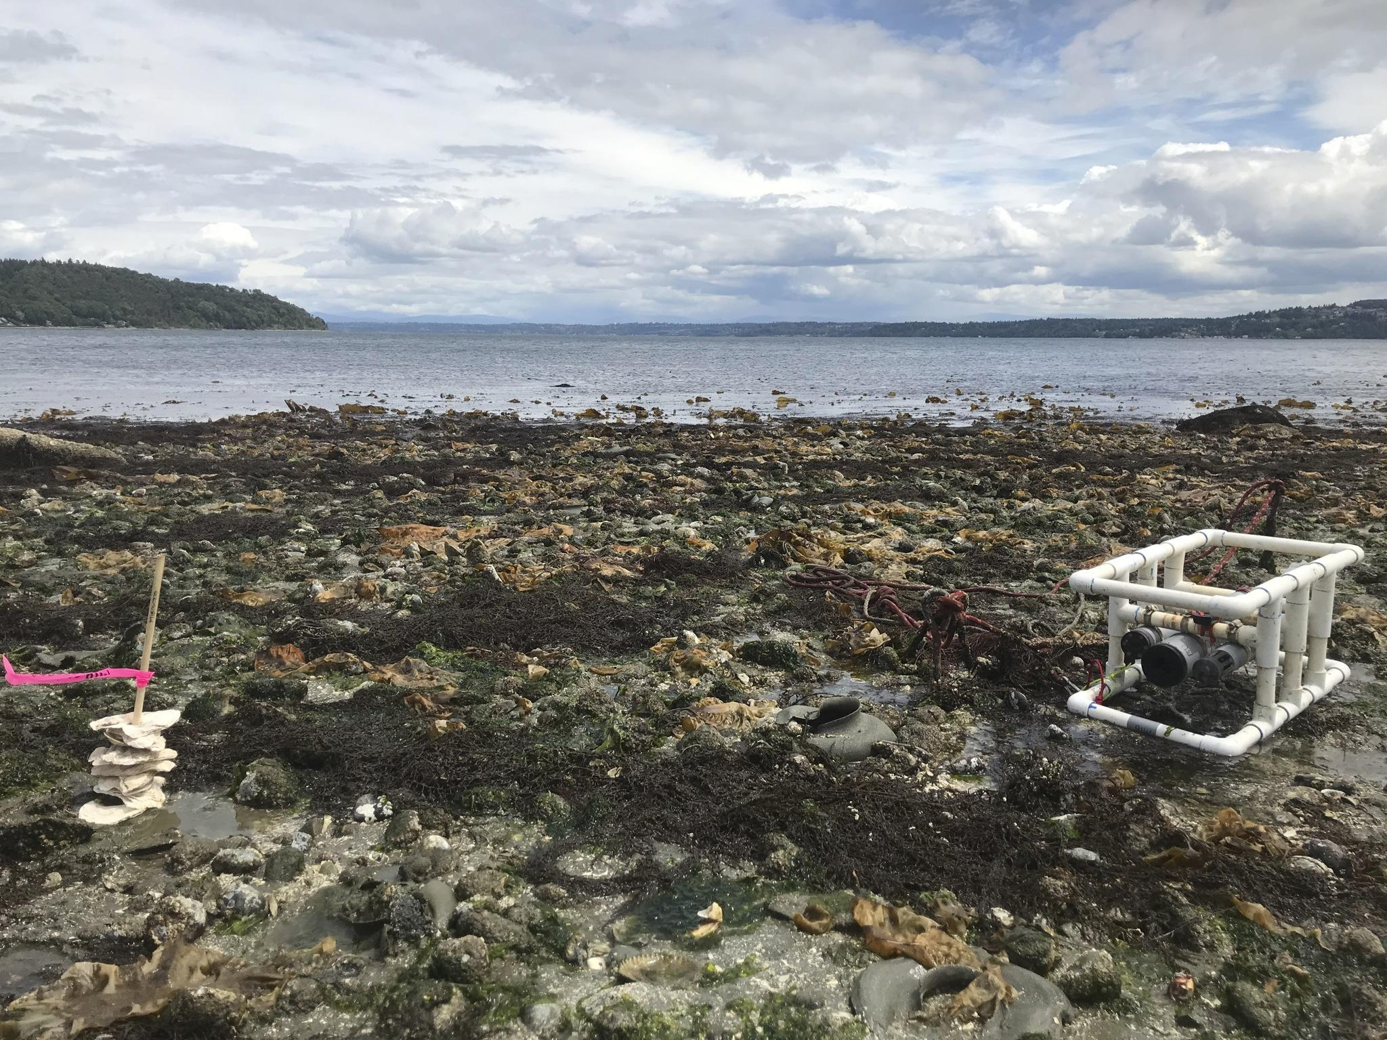
Eelgrass Review
Eelgrass is a flowering marine plant that grows in nearshore areas
It grows in sandy or muddy substrate, typically in shallow waters so sunlight can reach the plant
Absorbs light energy from the sun and sequesters CO2 from the water to produce O2 and sugar through photosynthesis
Photo by WA DNR, ANeMoNe
Notes:
Note to teacher: Emphasize again that eelgrass sequesters carbon as this is important for understanding our ocean acidification lessons.

Slide 5
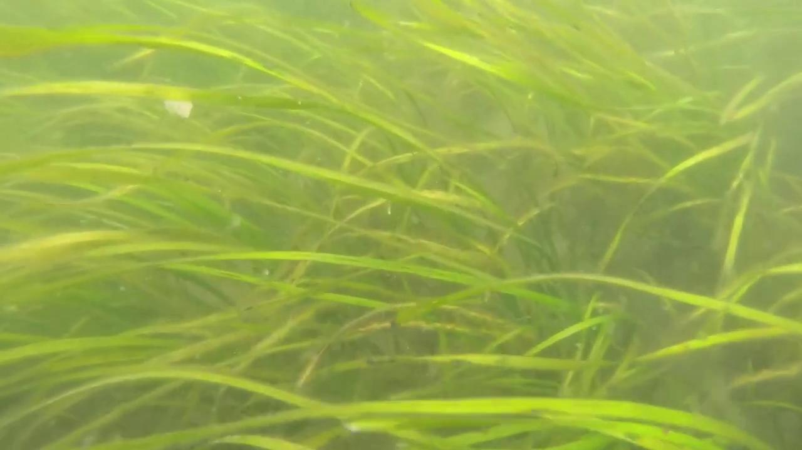
Eelgrass Video
Notes:
Note to teacher: Emphasize again that eelgrass sequesters carbon as this is important for understanding our ocean acidification lessons.

Slide 6
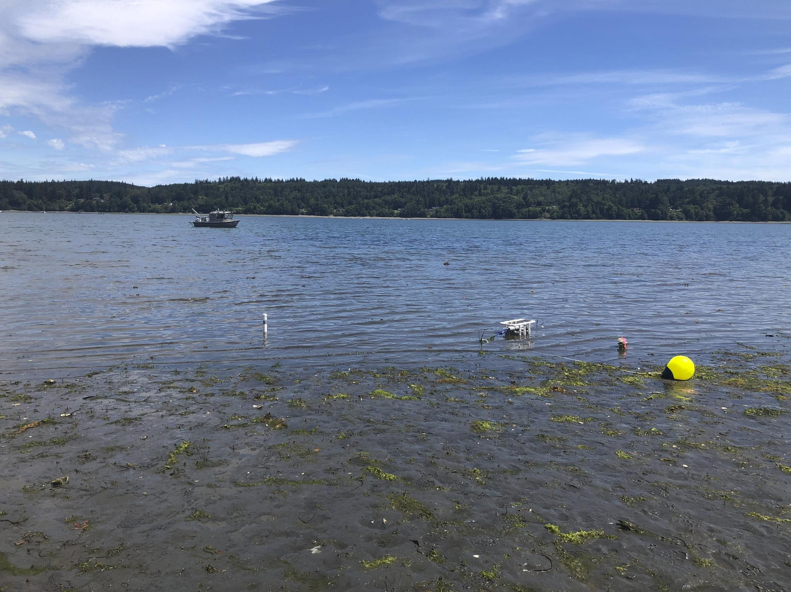
What habitat does eelgrass create?
As a primary producer, eelgrass forms the base of its ecosystem
Rhizomes stabilize the substrate where it grows, decreasing turbidity
Photosynthesizes to provide O2 to aquatic organisms
Provides complex habitat for many nearshore species by creating nursery habitat and protected areas for breeding
Photo by Washington DNR, ANeMoNe
Notes:
Note to teacher: Define primary producer and how this fits into food webs.

Slide 7
Activity 1:
Which species live in eelgrass ecosystems?
01
02
Brainstorm in groups what species you would expect to find in eelgrass ecosystems using what we’ve learned about the habitat it provides.
Share and discuss ideas with the class to come up with a class list of species.

Slide 8
Phytoplankton
Microscopic plants that photosynthesize to create food
Zooplankton
Microscopic animals that eat plants
Bivalves
(Oysters, mussels, clams) Strain microscopic particles out of water for food
Dungeness crabs
Omnivores that eat either plants or animals depending on what is available
Cormorant
Carnivores feeding primarily on fish
Juvenile salmon
Carnivores with stripes and spots on their body for camouflage
Juvenile rockfish
Omnivores that feed on zooplankton, shrimp and other small marine organisms
Orca whale
Top predators with diets including fish and marine mammals
Harbor seal
Carnivores that eat fish, shellfish, and crustaceans

Slide 9
Activity 2:
Species Cards

Slide 10
Activity 2:
Species Cards
01
02
03
Each group will receive a stack of species cards depicting species that are found in the eelgrass ecosystem and paper to draw on.
As a group, sort out the species cards to create a food web demonstrating interactions between the species, i.e. who eats who.
Draw a food web showing the interactions.

Slide 11
Exit Question
Hypothesize how these relationships might change if more CO2 is absorbed (we will revisit these ideas in Lesson 3).
How does eelgrass help?

