Slide 1
ENSO: A Problem-Based Approach
Designed for use in a year long dual credit high school Climate and Oceanography Course
Author: Nancy Flowers
Created: October 18, 2014
Edited by Miriam Bertram July 21, 2020 for use in pressbooks with permission from the author.

Slide 2
Brief Bio
I’ve been teaching at Everett High School for 28+ years
Core teaching assignments have been AP Chemistry and General Chemistry
I have taught the dual enrollment UWHS Ocean 101 for several years.
I helped write curriculum for UWHS ATMS 211 (climate) and taught the full course.

Slide 3
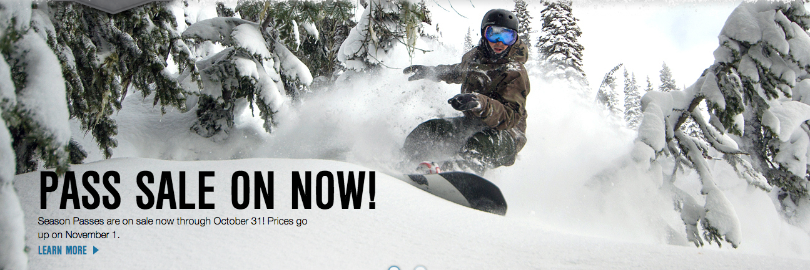
The Problem
Ski season is approaching, and your family must decide by Oct. 31 whether to buy season passes at Stevens Pass, or pay the more expensive daily rate.
What information would you need to collect to make your decision?
Notes:
Question for educators. This PBL question was posed in 2014. If/how has the timing of the ski season in your region changed since 2014?

Slide 4
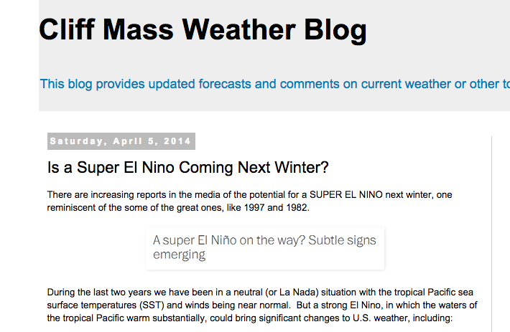
April 5, 2014

Slide 5
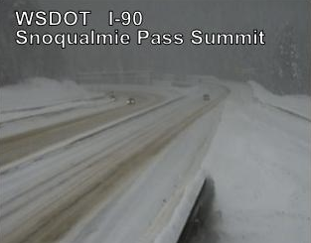
El Niño & PNW Winters
In your opinion, how do El Niño and La Niña events impact temperature and precipitation in the Pacific Northwest?
Do you have any personal history related to El Niño or La Niña events?
How might this impact your decision to buy a season pass, instead of paying the higher daily rate?
Please insert your own exciting ski photo.

Slide 6
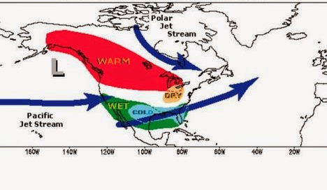
Typical El Niño Winter Pattern

Slide 7
To make our decision, we need to…
Understand neutral (normal), El Niño and La Niña conditions in the tropical Pacific.
Use tropical Pacific buoy data to make a climate prediction for winter, 2014-2015.
Examine the correlation between precipitation patterns in the Pacific Northwest and El Niño/La Niña events.

Slide 8
Facilitated small group discussions
How are atmospheric and oceanic conditions different during neutral (normal), El Niño and La Niña conditions in the tropical Pacific?

Slide 9
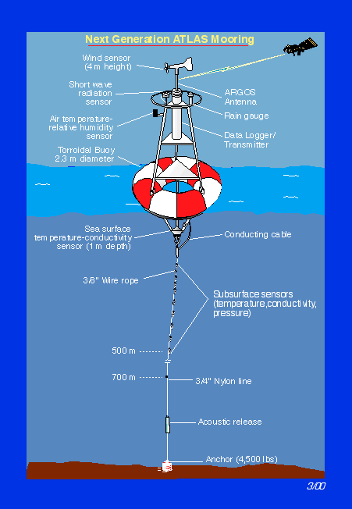
PMEL Data
The TAO/TRITON system consists of 70 moored buoys in the tropical Pacific
Data is collected and delivered via satellite to shore-based stations
Photo downloaded from https://www.pmel.noaa.gov/gtmba/moorings.

Slide 10
Working with TAO/Triton Data
Click on Lat/Long plots
Use Monthly time range
Select 2011, December
Click Make Plot!
You are viewing a Sea Surface Temperature graph from 10 °S to 10 °N, across the Pacific from South America to Australia

Slide 11
December, 2011: Normal, El Niño or La Niña? Evidence?

Slide 12
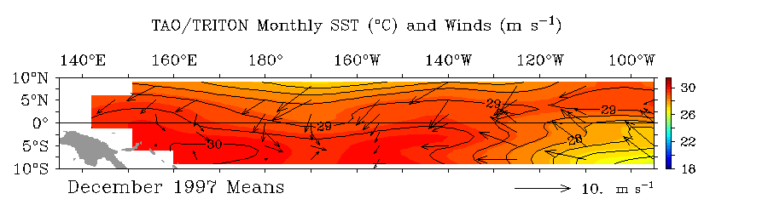
Now try the same analysis: December, 1997
El Niño or La Niña? Evidence?

Slide 13
Make a plot for September, 2014
What’s your analysis?

Slide 14
Tropical Pacific SSTs
Tropical Pacific SSTs are normally cold (< 26 °C) along a narrow band along the equator in the central and eastern Pacific
This is caused by easterly trade winds along the west coast of South America and Ekman transport of surface water towards the west
Cold water upwells along the west coast of South America and moves west along the equator
Coastal Upwelling Animation

Slide 15
Cold Tongue Index
The region of equatorial cold SSTs is referred to as the “cold tongue”
The cold tongue index is defined as the SST anomaly from 6 °N to 6 °S and 90 °W to 180 °W

Slide 16
Reading the CTI
A positive CTI means SSTs in the region are warmer than normal
El Niño conditions
A negative CTI means SSTs in the region are colder than normal
La Niño conditions

Slide 17
Data Analysis
CTI and precipitation in Indonesia
Open the ENSO investigation spreadsheet
Select the first tab—Cold Tongue, Indonesia
Select cells A1-B61. Make a scatter plot of year vs. CTI.
Can you spot the La Niña and El Niño years?

Slide 18
Data Analysis
Year | CTI Index | El Niño or La Niña? | High or low precipitation expected?
1951 | 0.76
1955 | -1.12
1982 | 2.06
1997 | 2.10
2000 | -0.64
2007 | -1.27

Slide 19
CTI vs. Indonesia Precipitation
Click and drag to select cells A1-C61. Insert a scatter plot.
Right-click on the red Indonesia line, select “Secondary Axis”
Stretch the graph out for ease of viewing.

Slide 20
CTI vs. Precip in Indonesia
Can you see any trends?

Slide 21
Using Math
We can use statistics to confirm our visual inspection
We will calculate the correlation coefficient between CTI and Indonesia Precipitation

Slide 22
Calculating the Correlation Coefficient
In cell F57, enter the following formula:
=correl(B31:B52,C31:C52)
ENTER
View the Correlation Coefficient in cell F57

Slide 23
Interpreting the Correlation Coefficient
1 → strong direct relationship
-1 → strong inverse relationship
0 → no relationship
For a correlation coefficient of -0.889, describe the relationship between the CTI and Indonesian Precipitation

Slide 24
Back to Ski Season!
Based on predicted climate impacts on the second tab in the SS, predict precipitation patterns in Everett during a typical La Niña and El Niño year
Predict the El Niño or La Niña impact on snowfall at Mt. Rainier

Slide 25
PNW Data
Note Mt. Rainer precipitation is yearly snowfall
Everett data is Oct-Mar rainfall
Make a scatter plot of CTI vs. Snowfall at Mt. Rainier
Calculate the correlation coefficient
Make a scatter plot of CTI vs. Oct-Mar Rainfall in Everett
Calculate the correlation coefficient

Slide 27
Decision Time!
Based on your analysis of:
September TAO SST data in the tropical Pacific
Correlation of conditions in the tropical Pacific (CTI) with historic precipitation and snowpack data in the PNW
Should you buy a season’s ski pass this year?

Slide 28
What Does Cliff Say?
Blog

