Slide 1
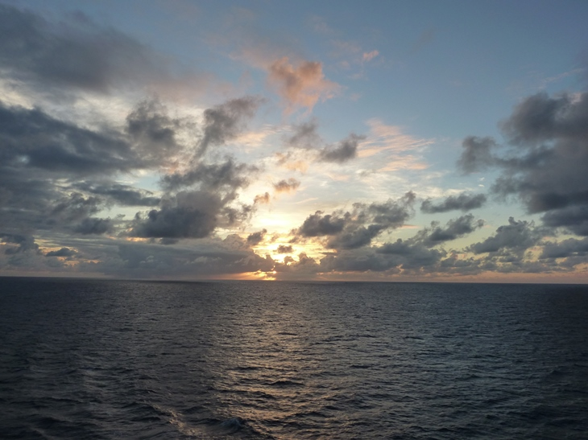
Introduction
UWHS Oysters and Ocean Acidification Module
Developed by Hilary Palevsky
(palevsky@uw.edu)

Slide 2
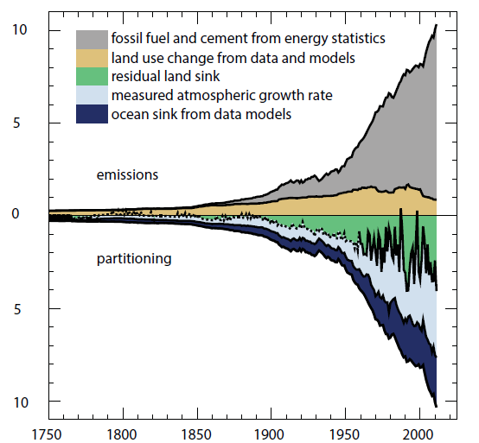
Carbon emissions and sinks
Pg C/yr
IPCC AR5, Figure 6.8
Notes:
Anthropogenic carbon emissions to the atmosphere (shown in the top half of the graph) do not all stay in the atmosphere: about half of that fossil fuel carbon accumulates in the atmosphere (light blue wedge in the bottom half of the graph), and the rest is taken up by the terrestrial biosphere (land sink, shown in green) and the ocean (dark blue). In total the oceans have absorbed ~30% of all of the anthropogenic carbon added to the atmosphere since 1750. This has the positive effect of slowing down the accumulation of carbon dioxide in the atmosphere, reducing the greenhouse effect, but it also has negative consequences because the absorbed carbon dioxide is changing the chemistry of the ocean in ways that can be harmful to marine life.
Figure 6.8 AR5, Annual anthropogenic CO2 emissions and their partitioning among the atmosphere, land and ocean (PgC yr–1) from 1750 to 2011.

Slide 3
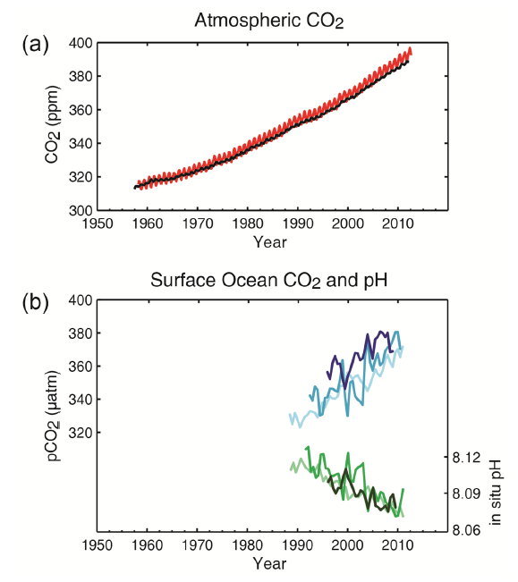
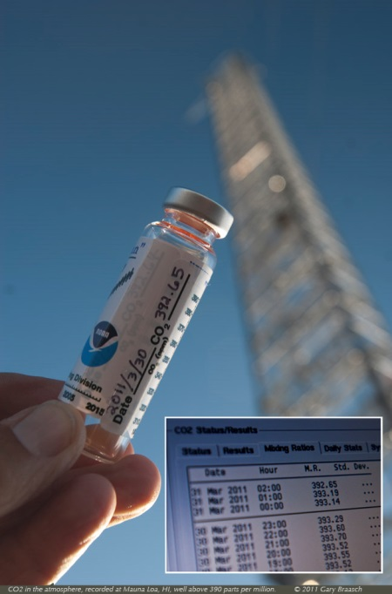
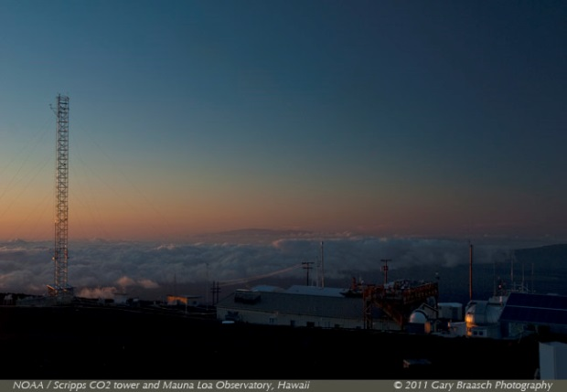
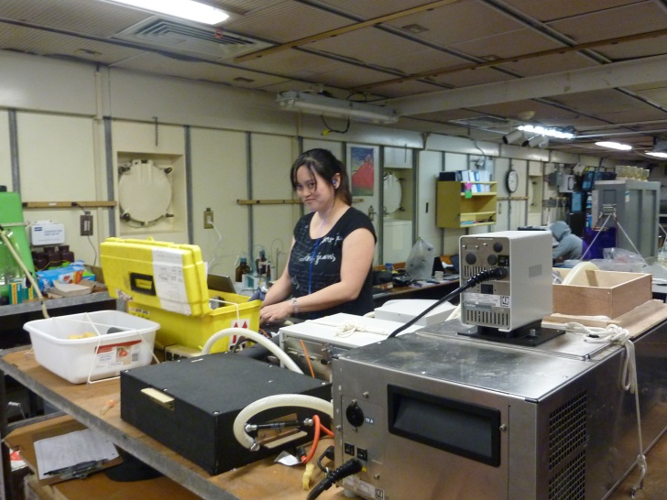
Absorbing CO₂ changes ocean pH
Hawaii (Mauna Loa)
South Pole
Hawaii (ALOHA)
Bermuda (BATS)
Canary Is. (ESTOC)
IPCC AR5, Figure SPM.4
Notes:
We can see evidence that as more carbon dioxide has accumulated in the atmosphere (top left), there has also been an increase in the amount of carbon dioxide dissolved in the ocean (blue lines in the bottom left graph, which show surface ocean pCO2). At the same time, the surface ocean pH (green lines in the bottom left graph) has decreased.
Notes on the figures:
The two pictures at the top right are of the Mauna Loa atmospheric CO2 measuring station in Hawaii showing the view looking at the measurement tower (left) and an air sample collected as part of the measurement program (right). The picture at the bottom is of a UW undergraduate student making measurements of seawater pH in a research ship’s laboratory while at sea. I like to emphasize the importance of scientific monitoring over a long time period (and hard work by many scientists to make very precise measurements) to generate the data plotted in the graphs to the left. I also discuss with students the fact that the ocean measurements show more variability around the long-term trend than the atmospheric measurements (due to slower mixing and variability in the natural system), requiring measurements over a long time period to illustrate trend.
The graphs at the left show atmospheric CO2 (top) from both Mauna Loa and the South Pole and surface ocean CO2 and pH (bottom) from three different locations:
ESTOC = Estación Europea de Series Temporales Oceánicas de Canarias – Canary Islands, eastern North Atlantic Ocean
BATS = Bermuda Atlantic Time Series – Bermuda, western North Atlantic Ocean
ALOHA = A Long-term Oligotrophic Habitat Assessment (at HOT = Hawaii Ocean Time-series) – Hawaii, North Pacific Ocean

Slide 4
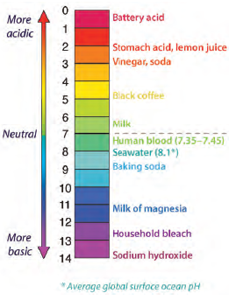
What is pH all about anyway?
pH = -log[H⁺]
Decrease in pH = increase in acidity
Logarithmic scale
  A decrease of 1 unit is a 10× increase in [H⁺]
  A decrease of 0.1 unit (observed in the ocean between 1750 and today) is a 26% increase in [H⁺]
Notes:
pH is a logarithmic scale used to measure the acidity of a liquid, with acidity increasing as the pH decreases. Emphasize that the important factor being measured is the concentration of hydrogen ions (expressed as [H+]) in the seawater. Since pH is expressed on a logarithmic scale, a change of a single unit on the pH scale is a 10x change in [H+]. Many people think that the change in ocean acidity since pre-industrial times is small because it is only a 0.1 unit change on the pH scale, this is actually a 26% increase in [H+]. A useful analogy can be made to human blood, which has to stay within the range of 7.35-7.45 for us to be healthy – a larger change can have serious consequences.
If students need more practice thinking about pH at this point, you can guide them through the calculation of how large a % change in [H+] has occurred to date as the ocean pH has decreased from 8.2 to 8.1 rather than simply giving them the 26% number. (This is the same type of calculation students will complete independently in Part 3 of the module.)
Figure from WA State Blue Ribbon Panel on Ocean Acidification

Slide 5
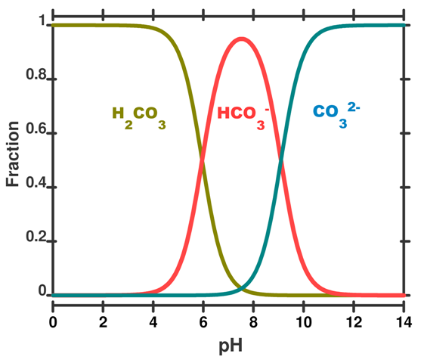
Ocean carbonate chemistry
CO₂ dissolution in water:
CO₂ + H₂O ↔ H₂CO₃
H₂CO₃ ↔ H⁺ + HCO₃⁻
HCO₃⁻ ↔ H ⁺ + CO₃²⁻
What happens to [H⁺] as CO₂ dissolves?
How does this change pH?
Notes:
As CO2 dissolves in water, it reacts with H2O to form carbonic acid (H2CO3). The H2CO3 can then dissociate, with two H+ ions that it can be added to the seawater. Even though CO2 does not contain hydrogen in its chemical formula, the net effect of CO2 dissolution is to add H+ ions to the seawater, which decreases the pH.
A note for teachers: It is not necessary for the students to fully understand how these three equations interact in order to have a good grasp on the process of ocean acidification. Often, however, some students are confused because if each of the reactions shown here went to the right (towards the products), there would be an increase in the carbonate ion (CO32-) – but what actually occurs is that the final reaction instead proceeds to the left, towards the reactants, reducing the amount of CO32-. This is due to the interaction between the differing reaction constants for each reaction in the sequence. A helpful illustration can be to look at the figure to the right (called a Bjerrum plot), which shows how the relative proportions of carbonic acid (H2CO3), bicarbonate ions (HCO3-) and carbonate ions (CO32-) change as a function of the pH of the water. As more CO2 is added to the water, there are more H+ ions and thus pH decreases. If you look on the plot at a pH of ~8.1 and then follow how the concentrations of each ion will change as you decrease pH (moving to the left), you will see that CO32- decreases and HCO3- increases.
If you want more background on the chemistry, you can find a comprehensive but accessible overview at http://www.skepticalscience.com/docs/OA_not_OK_Mackie_McGraw_Hunter.pdf

Slide 6
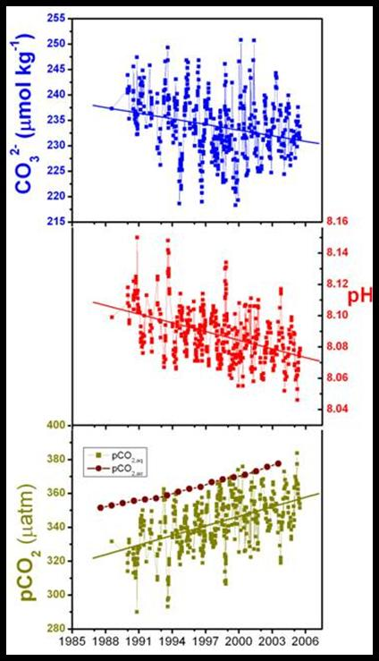
How does acidification affect CaCO₃ shells?
Forming CaCO₃ shells:
Ca²⁺ + CO₃²⁻ ↔ CaCO₃
Ω = [Ca²⁺][CO₃²⁻]/K_{sp}
When Ω < 1, water is undersaturated and CaCO₃ will dissolve
Notes:
Many marine organisms build shells out of calcium carbonate. (Note: calcium carbonate can form two different mineral structures, calcite and aragonite. Aragonite is the mineral most commonly used by organisms – including oysters - to build their shells.) In order to form calcium carbonite, they need to precipitate calcium carbonate out of the water, which occurs when the reaction proceeds in the forward direction. If the reaction proceeds in the backwards direction, calcium carbonate will dissolve. Since this is an equilibrium reaction that can proceed in either direction, we can calculate which direction the reaction will tend to proceed by calculating omega (Ω), the saturation state of the water, which is based on the concentrations of the Ca2+ and CO32- ions (the reactants) and an equilbrium constant (Ksp). When Ω > 1, the reaction will tend to go to the right towards the products (i.e. precipitating CaCO3), but when Ω < 1, the reaction will instead tend to go to the left towards the reactants (i.e. dissolving CaCO3). For marine organisms, the higher the Ω of seawater, the easier it is for them to form their calcium carbonate shells.
The figure on the right demonstrates empirically (as could also be discussed based on the reactions and figure on the previous slide) that as the pH of the ocean decreases, the concentration of carbonate ions ([CO32-]) also decreases. Looking at the equation for Ω, you can see that it is directly proportional to [CO32-], so this means that as pH decreases, Ω will also decrease, making it harder for organisms to precipitate the calcium carbonate for their shells.
Figure from http://coralreefwatch.noaa.gov/satellite/oa/description/oaps_intro_oa.php

Slide 7
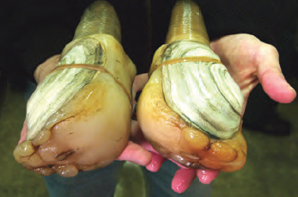
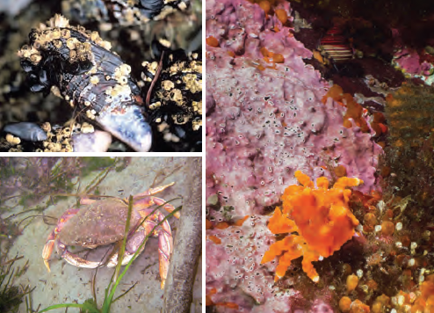
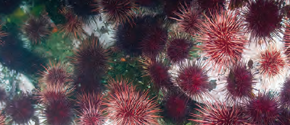
Calcifying organisms
Geoduck
Blue mussel
Pink calcifying algae
Urchins
Dungeness crab
Juvenile king crab
Examples of Puget Sound organisms that build shells, skeletons or other hard parts from CaCO₃
Images from Washington State Blue Ribbon Panel on Ocean Acidification Report, 2012
Notes:
These are all examples of organisms found locally in the Puget Sound that build their shells, skeletons or other hard parts from calcium carbonate. You can begin to make a direct connection to students’ lives and the local economy by asking students who has eaten any of the organisms shown here.

Slide 8
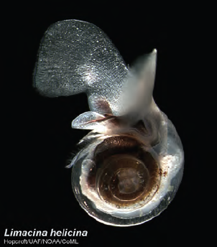
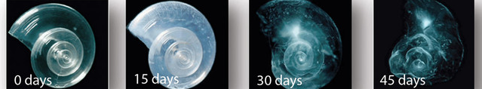
Pteropods: OA poster child
Zooplankton, swimming snail
Food for young salmon
Shells dissolve in low pH waters
Already observed shell dissolution damage in Pacific Ocean off US west coast
Pteropods dissolve in water with pH and carbonate chemistry expected for 2100
Notes:
Pteropods are a vital part of the food web, providing an important part of the diet of many important fish species such as salmon, herring and mackerel. They have thin calcium carbonate shells and thus are particularly sensitive to the effects of ocean acidification, as can be seen in the laboratory experiment shown at the bottom where a pteropod shell severely dissolves when placed in water with the pH and carbonate chemistry expected in the ocean by the year 2100. However, even now, scientists have already observed pteropods in the wild already beginning to dissolve in current seawater conditions. A 2012 study showed pteropods with signs of shell dissolution for the first time in the Southern Ocean around Antarctica, and a new study from 2014 shows that pteropods in the California Current off the coasts of California, Oregon and Washington are also showing signs of severe shell dissolution as the result of exposure to seawater with low pH.
For more information on pteropods and the study showing that they are dissolving in the Pacific Ocean off the US west coast, see http://apps.seattletimes.com/reports/sea-change/2014/apr/30/pteropod-shells-dissolving
Images from Washington State Blue Ribbon Panel on Ocean Acidification Report, 2012

Slide 9
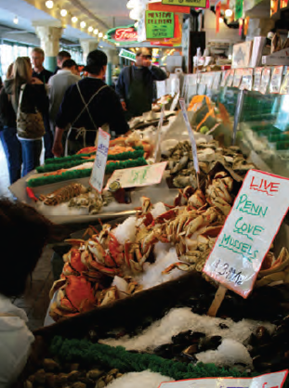
Shellfish industry in Washington
Washington is the country’s leading producer of farmed oysters, clams and mussels
$270 million annually from shellfish aquaculture
3,200 jobs created by shellfish growers
Washington State Blue Ribbon Panel on Ocean Acidification Report, 2012
Notes:
Shellfish aquaculture plays an important role in the economy of Washington state. In addition to the economic impact and jobs listed here, which are specifically for shellfish aquaculture, Washington also has large recreational and wild fishing industries that could be affected by ocean acidification impacts on other organisms (for instance if salmon were negatively affected by the loss of pteropods).
Economic statistics from the Washington State Blue Ribbon Panel on Ocean Acidification Report, 2012

Slide 10
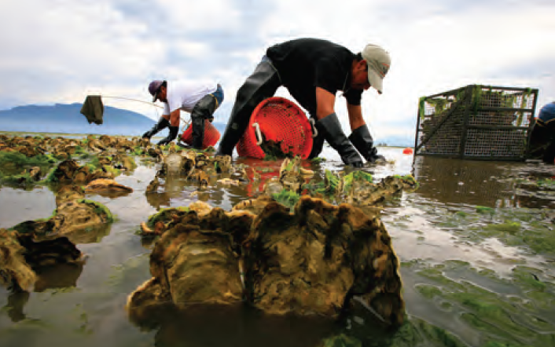
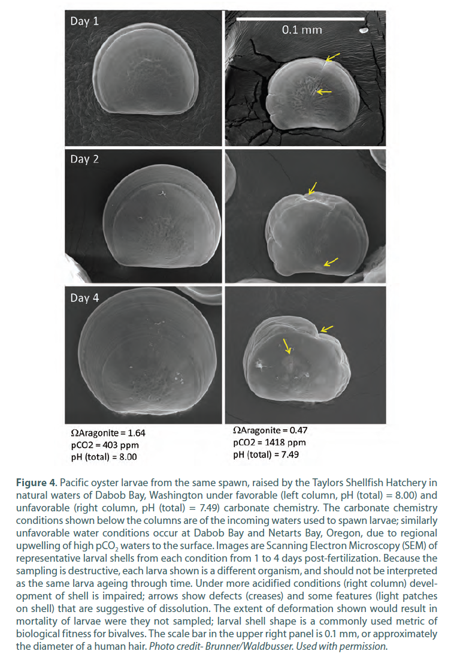
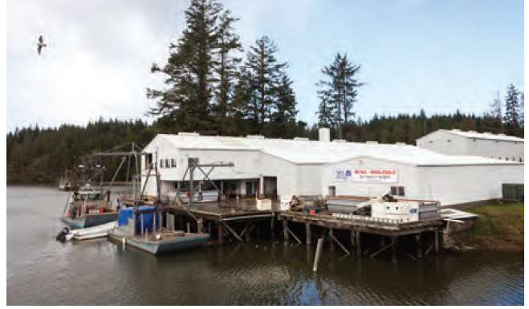
Impact on oyster growers in the Pacific Northwest
WA Blue Ribbon Panel Report, 2012
Notes:
Most commercially-grown oysters begin their lives in hatcheries, where they adults are spawned and the baby oysters (called larvae) are grown for the first few weeks of their lives until they are large enough to be “planted” at oyster farms along the coast where they will grow up to the full size that can be sold for people to eat. There are only a few hatcheries in the Pacific Northwest, which supply the oyster larvae (or “seed”) to many of the commercial oyster farms in the region. In the mid-late 2000s, the larval oysters began dying at hatcheries along the Washington and Oregon coasts. Oyster farmers were unable to get larvae to plant on their farms, and oyster production plummeted, putting the industry at risk. The oyster growers wanted to know what was causing this problem; ocean acidification, still a new field of scientific research in the mid-2000s, was one potential culprit.
Pictures to the left are of oyster farming in practice (top: harvesting adult oysters, bottom: Nisbet Oyster Company in Williapa Bay, WA)
The set of image on the right illustrates the difference between what healthy and unhealthy larval oysters look like under a microscope during their first few days after fertilization (the 0.1 mm scale bar is about the width of a hair). On the left are images from oysters grown in favorable seawater conditions (pH = 8.0, Ω = 1.64) whereas the oysters on the right were grown in unfavorable seawater conditions (pH = 7.49, Ω = 0.47), both found in the natural waters at Taylor Shellfish Hatchery in Dabob Bay, WA. You may discuss this image and tell students before they complete Part 1 that ocean acidification was in fact the reason the hatchery oysters were dying, or you may choose to wait and have the students find this first themselves in their analysis. This image is repeated in the follow-up slides for Part 1.
If you want to go into more depth about the human connection with local shellfish growers, you can show this 4-minute video from Taylor Shellfish talking about their multi-generation family business growing oysters and how they are being affected by ocean acidification: http://vimeo.com/93272507
More information about the oyster industry and how it has been affected by ocean acidification: http://apps.seattletimes.com/reports/sea-change/2013/sep/11/oysters-hit-hard

Slide 11
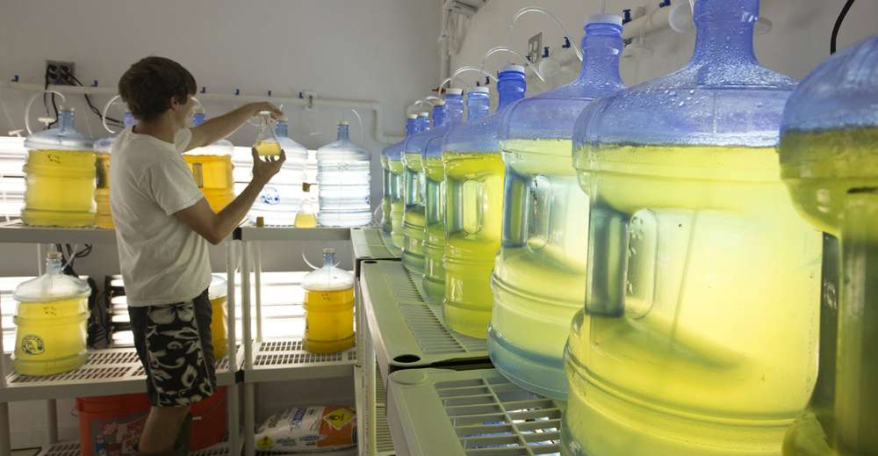
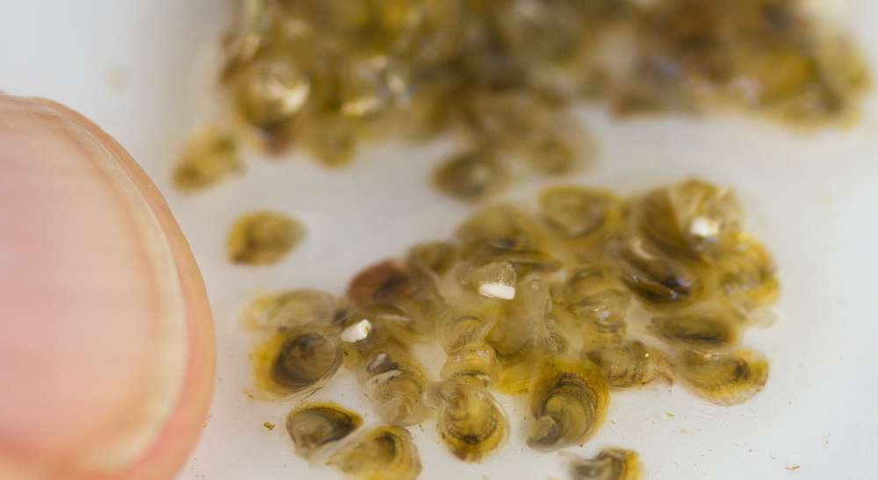
Your problem: How is ocean acidification affecting oyster larvae?
Photos: Steve Ringman, The Seattle Times
Use data from Whiskey Creek Hatchery to investigate the relationship between water chemistry and oyster larval growth
Explain your findings and provide advice to the hatchery managers
Notes:
Whiskey Creek Hatchery in Netarts Bay, Oregon began experiencing problems with growing their larval oysters in 2008. They formed a collaboration with scientists at Oregon State University, who monitored the chemistry of the seawater being pumped into the hatchery and used to grow the larval oysters. The goal of their study was to determine whether ocean acidification was causing their problems growing oyster larvae and to try to come up with adaptations to the way the oyster hatcheries operate that could help them solve their problem with oyster larvae production. In the rest of this module, students will analyze real data collected by the OSU scientists and by oyster growers working at the hatchery in order to answer these questions.
Left image: This is an image from inside a hatchery, showing a hatchery transferring algae from a beaker to a larger tank.
Right image: This is the size the larval oysters reach by the time they are ready to be transferred from the hatchery to be planted and grown to full size.

Slide 12
Part 1
UWHS Oysters and Ocean Acidification Module
Developed by Hilary Palevsky
(palevsky@uw.edu)

Slide 13
How do changes in Ω affect oyster larvae?
Notes:
This is the same graph that students should have created in Excel while completing Part 1 of the worksheet. Show this version while discussing the students’ worksheet responses as a class.

Slide 14
How do changes in Ω affect oyster larvae?
Whiskey Creek Hatchery,
Netarts Bay, OR
Taylor Shellfish Hatchery,
Dabob Bay, WA
Barton et al., 2012
WA Blue Ribbon Panel Report
Notes:
The graph on the bottom left is the same as the one they have created in their own data analysis – but this is the version that was published in a scientific journal by the OSU scientists and hatchery workers. I recommend taking this opportunity to emphasize the fact that students are working with real scientific data and have completed the same type of analysis that is completed and published by professional scientists.
The set of image on the right illustrates the difference between what healthy and unhealthy larval oysters look like under a microscope during their first few days after fertilization (the 0.1 mm scale bar is about the width of a hair). On the left are images from oysters grown in favorable seawater conditions (pH = 8.0, Ω = 1.64) whereas the oysters on the right were grown in unfavorable seawater conditions (pH = 7.49, Ω = 0.47), both found in the natural waters at Taylor Shellfish Hatchery in Dabob Bay, WA. You can see that the oysters on the left have grown smooth, round shells while the ones on the right are deformed and show a number of marked spots where dissolution has occurred. The oysters on the right are growing so poorly that they would be expected to die before growing to full size. This is what is causing relative larval production to decrease as Ω decreases.

Slide 15
Part 2
UWHS Oysters and Ocean Acidification Module
Developed by Hilary Palevsky
(palevsky@uw.edu)

Slide 16
Photosynthesis and respiration
CO₂ + H₂O ↔ CH₂O + O₂
Photosynthesis
Respiration
Photosynthesis requires sunlight
Respiration occurs both day and night
How do you expect photosynthesis and respiration to change pH and Ω?
Notes:
[Optional: use if students are not already familiar with photosynthesis and respiration]
Key concepts are that photosynthesis and respiration in the seawater can change pH and Ω by consuming/producing CO2. Remind students of the reaction for photosynthesis/respiration and of the fact that photosynthesis only occurs in daylight, whereas respiration occurs all the time. This sets students up to identify that the diurnal cycle of pH and Ω in Netarts Bay is created by drawdown of CO2 during the day, when photosynthesis is occurring, which decreases pH and Ω, followed by an increase in pH and Ω at night when respiration is adding CO2 back to the water.

Slide 17
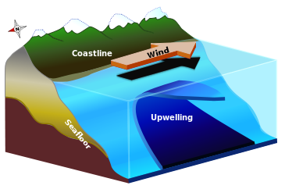
Coastal upwelling
When winds blow along to the south along the coast, surface water is pushed offshore
This causes deep water to upwells to the surface
Notes:
[Optional: use if students are not already familiar with upwelling]
This is very cursory explanation designed only to make it possible for students to complete the analysis of the ocean acidification module.
Image from Wikimedia Commons

Slide 18
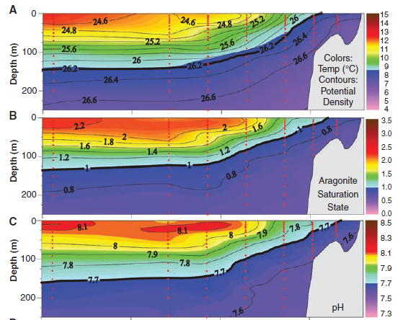
Properties of deep water brought to the surface by upwelling
Colder
Saltier
More CO₂ (respiration but no photosynthesis in deep water)
Feely et al., 2008
Notes:
[Optional: use if students are not already familiar with the properties of upwelled water]
The figures at the left show real data collected off the US west coast, with the data plotted going down through the top 250 meters of the water column from W (left, offshore), to E (right, next to the coast). The plots show warmer water with higher pH and Ω at the surface and colder water with lower pH and Ω at depth, but also show that the deep waters are brought up towards the surface along the coast. A key point for students to understand is that deep waters have been out of contact with the surface and sunlight, so they have continued to accumulate CO2 as sinking organic matter is respired without the possibility for photosynthesis to remove any of that CO2. This is the reason that deep waters have low pH and Ω.

Slide 19
One week of pH and Ω_{aragonite} showing diurnal cycle
Notes:
This is a version of the graph that students should have created in question 2 of Part 2 (though each will be slightly different because students could have chosen any 7-day window throughout the measurement period to graph). Show this version while discussing the students’ worksheet responses to question 2 as a class.

Slide 20
Notes:
These are versions of the graphs that students should have created in questions 3-4 of Part 2. Show these graphs while discussing the students’ worksheet responses to questions 3-4 as a class.

Slide 21
Part 3
UWHS Oysters and Ocean Acidification Module
Developed by Hilary Palevsky
(palevsky@uw.edu)

Slide 22
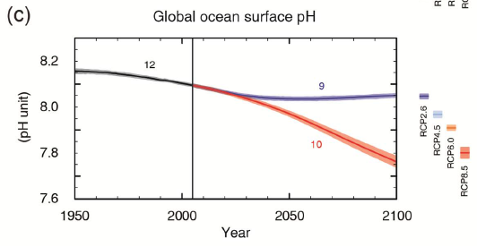
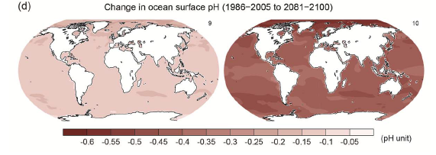
Future projections
IPCC AR5 SPM.7
RCP 2.6 (low future emissions)
RCP 8.5 (high future emissions)
IPCC AR5 SPM.8
Notes:
The top graph here is included in Part 3 of the students’ worksheet and provides the projections of pH until 2100 that the students use to make their calculations in question 1 (note that students may pick slightly different pH values off of the graph and thus will not all have the exact same answers).
In discussing the students’ answers to question 2 as a class, you can also expand the discussion to talk about how the pH is not uniform throughout the ocean, and the changes expected for each emissions scenario are also not the same everywhere (as pictured in the bottom figures).

Slide 23
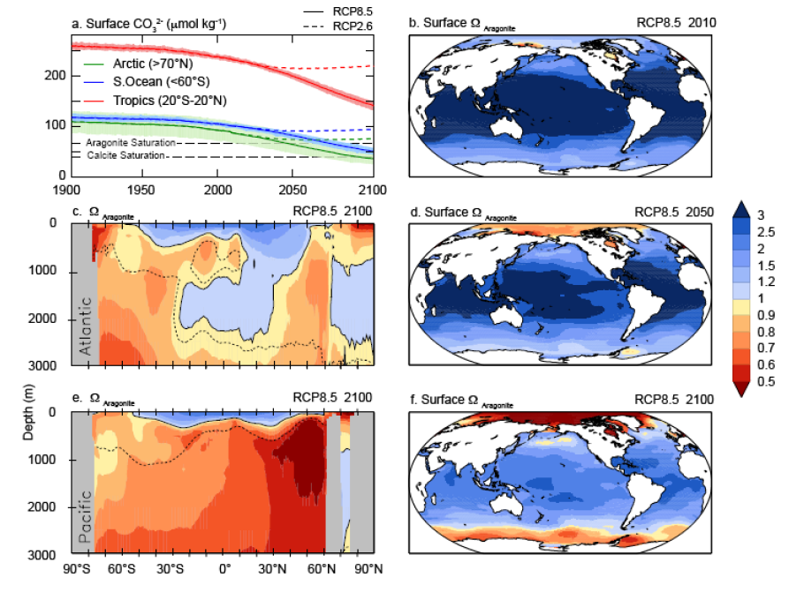
Future projections
IPCC AR5 Figure 6.29
Notes:
These figures can be used in an extension of the discussion of the students’ answers to question 2 in Part 3, highlighting the connection between the changes in pH expected by 2100 with the corresponding changes in Ω they would predict, and how they expect those changes would affect oysters.
The top left figure shows changes in CO32- over time for the high emissions scenario (RCP8.5) and the low emissions scenario (RCP2.6) as well as the concentrations of [CO32-] where Ω = 1 (the saturation lines for aragonite and calcite, the two different mineral structures for CaCO3 – the oysters are aragonite). It is a complicated plot, but the key point is that [CO32-] is decreasing in all regions of the ocean, with much more pronounced decreases in the high emissions scenario. Remind students of the direct relationship between [CO32-] and Ω.
The two bottom plots on the left show Ω variations with depth in the Atlantic and Pacific oceans for 2100 following the high emissions scenario. The three plots on the right show Ω throughout the 21st century when following the high emissions scenario. Note the spatial variability in Ω throughout the ocean, with lower Ω in deeper waters and at higher latitudes.

Slide 24
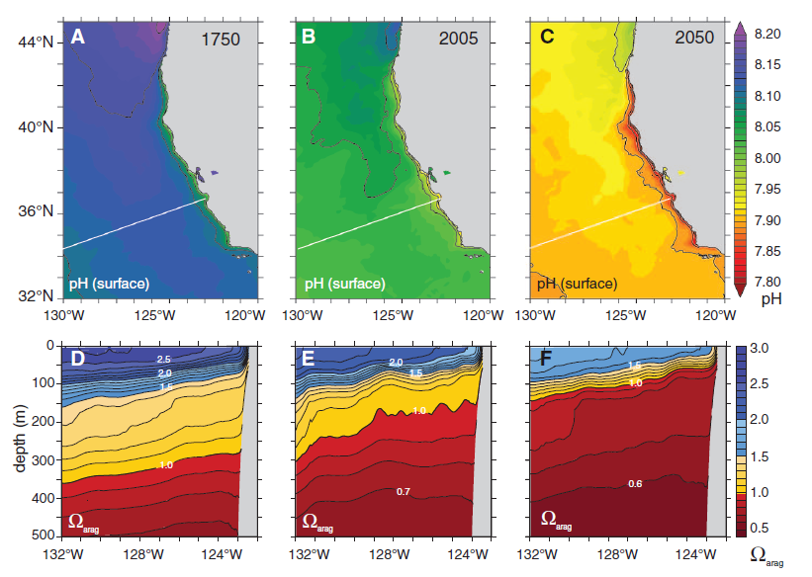
Future projections for the US west coast
Gruber et al., 2012
Notes:
In discussing the students’ answers to question 2 in Part 3 as a class, you can compare their projections of how pH and Ω will change in Netarts Bay with this study, which modeled how pH and Ω have change over time along the California coast following the high-emissions business-as-usual scenario (Gruber et al., 2012, published in Science). The bottom plots are cross sections going down through the water column showing Ω at the location of the white line in the top figures. If you just look at the surface at one spot you can see Ω decreasing over time. You can also see the effect of upwelling along the coast, where in all time periods, the pH is lower along the coast, and the tipped lines of constant Ω in the depth sections a the bottom show that Ω is lower near the coast than farther offshore.

