Slide 1
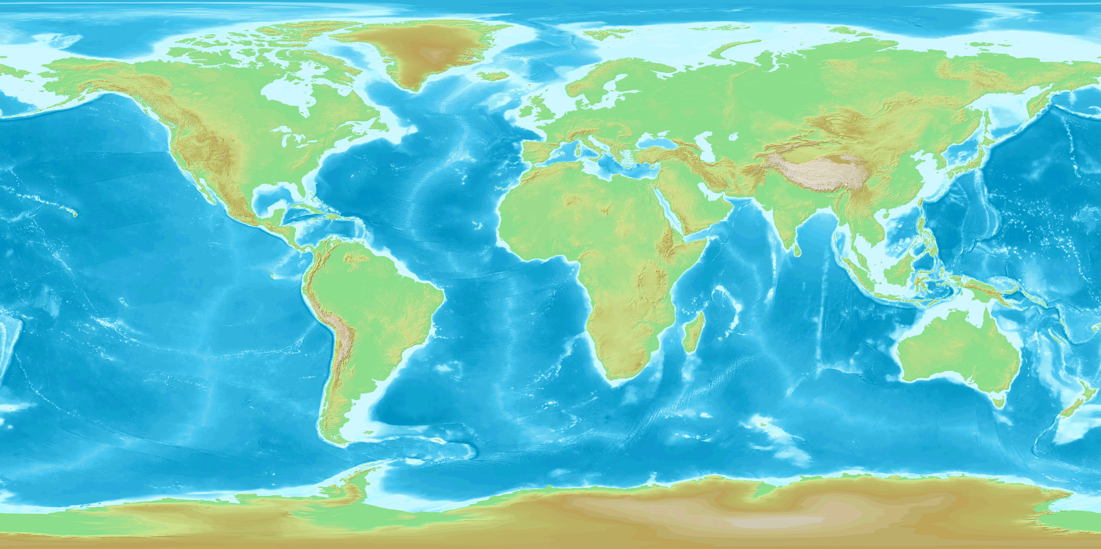
READY, SET, CURB!
THE NORTH POLE/ THE ARCTIC
2050
START
THE PACIFIC NORTHWEST -- HOME!
CLIMATE
IMPACT
TEAM
MICRONESIA
THE GREAT BARRIER REEF
TEAM
CLIMATE
IMPACT
This game was developed in partial fulfillment of a Graduate Certificate in Climate Science, and is dedicated to the game creator’s younger sister, Emmi.
TEAM
We encourage the reuse and dissemination of this game for noncommercial purposes as long as attribution is retained and any adaptations are shared with the same licensing. This work is licensed under a Creative Commons Attribution-NonCommercial-ShareAlike 4.0 International License.
CLIMATE
IMPACT
Attribution should include: Stote, A. (2019) Ready, Set, Curb!. Retrieved (date), from https://pcc.uw.edu/education/presentation-resources/
TEAM
TEAM
This Photo by Unknown Author is licensed under CC BY-SA
CLIMATE
IMPACT
CLIMATE
IMPACT
CLIMATE
IMPACT

