Slide 1
Citation as a Practice
Lesson Title: Citation as a practice
Slide ID: Introduction
Programming/Interactions
Visual:
Click button to begin.
Reviewer Comments
Start
Audio: This lesson begins with a pretest on basic bibliographic entry construction from a few common types of resources. Feel free to consult your copy of A Manual for Writers (“Turabian”) during the pretest. Click “Start” when your are ready to begin.
Feedback: Lesson advances upon click.
NOTES: Title slide: Learners come into the program with various level of skill and experience in citation and bibliography construction. This pretest should provide an entering baseline and allow users to progress to a level suited to their need.

Slide 2
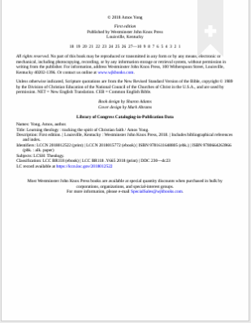
Lesson Title: Citation as a practice
Slide ID: Pretest (example)
Programming/Interactions
Visual:
Animate dragging elements in random order to correct blank in bibliographic entry. Identify elements as they are placed correctly. Provide one incorrect placement with correction.
______,____. ____:____. ____:_____,___.
Reviewer Comments
Continue
Audio: These are images of the title page and title page verso (back of the title page) of the textbook for this course. Watch as we drag elements from the images into their proper place in a well formatted bibliography entry. Click ”Continue” when you are ready.
Feedback: No feedback here; just a demonstration. Timer displayed.
NOTES: This animation is to introduce the learner to the activity they will be pre-tested on.

Slide 3
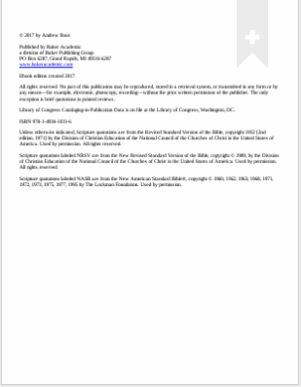
Lesson Title: Citation as a practice
Slide ID: Pretest (book)
Programming/Interactions
Visual:
Not all elements will be drag-able, but all needed information should be, as well as some information that is not needed.
No feedback at this stage. Format correct capitalization automatically.
______,____. ____:____. ____:_____,___.
Reviewer Comments
Continue
Audio: OK, your turn. Drag the elements of the of the information from this book to the form a proper bibliographic citation for this book. You may use the style guide (Turabian, 9th) but remember, this is a timed activity. Click “Continue” when you are satisfied with your entry.
Feedback: No feedback for learner here; feedback will be given at the end of the pretest. Timed activity with generous limit.
NOTES: This is not the best book to start out with (it is a book in a series, adding potential optional elements to the citation) but it suffices for a prototype and may be used in the class for some students.

Slide 4
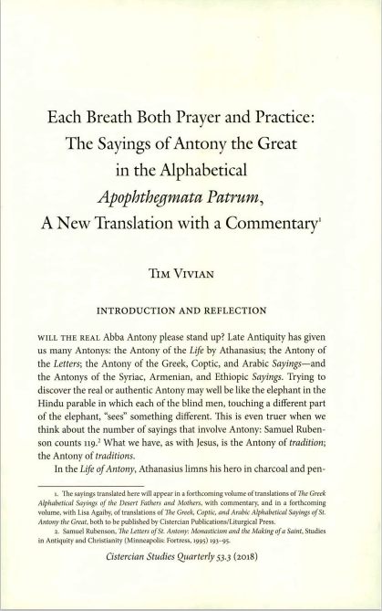
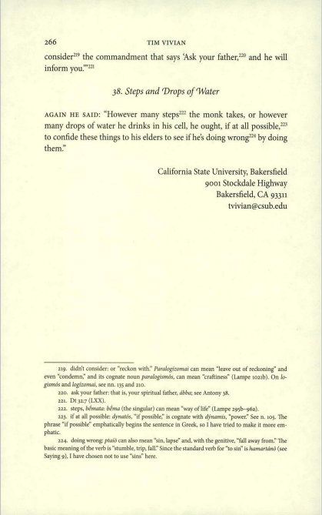
Lesson Title: Citation as a practice
Slide ID: Pretest (article)
Programming/Interactions
Visual:
Not all elements will be drag-able, but all needed information should be, as well as at least one piece of information that is not needed.
[235]
______,____. “____:____.” ____ __, no.__ ( ): _-_.
Reviewer Comments
Continue
Audio: Now let’s look at a journal article. Again, drag the elements from the first and last page of the article to construct a proper bibliographic entry for this article. (The first page number has been provided in square brackets as it does not appear on the first page of the article.). You may use the style guide (Turabian, 9th) but remember, this is a timed activity. Click ”Continue” when you are satisfied with your entry.
Feedback: No feedback for learner here; feedback will be given at the end of the pretest. Timed activity with generous limit
NOTES: There are decent number of clues here, but that may serve our purposes. Students will need some familiarity with this activity to correctly complete this pretest.

Slide 5
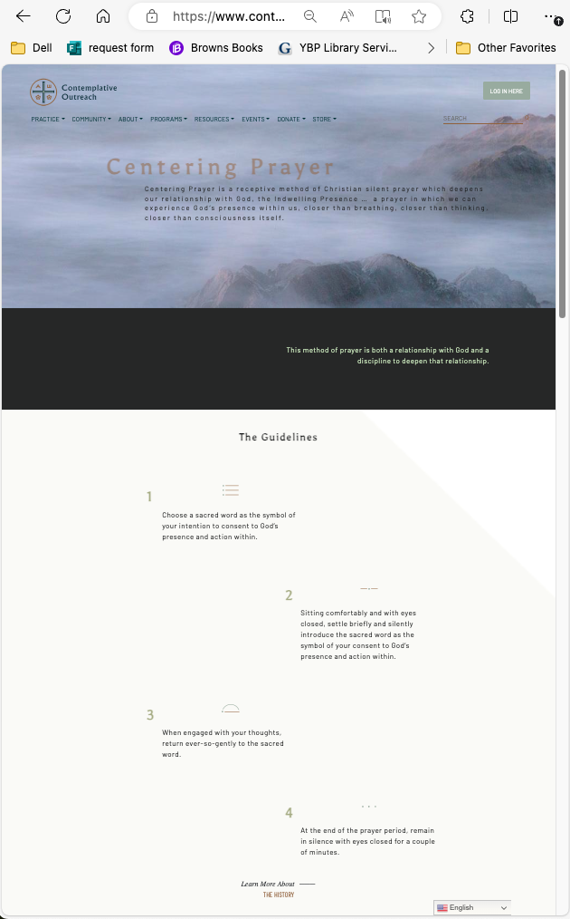
Lesson Title: Citation as a practice
Slide ID: Pretest (website)
Programming/Interactions
Visual:
Not all elements will be drag-able, but all needed information should be, as well as at least one piece of information that is not needed.
https://www.contemplativeoutreach.org/centering-prayer-method/
Reviewer Comments
________. “________” ____. ________.
Continue
Audio: Providing bibliographic entries from websites can be challenging: there is often limited and incomplete information, which frequently changes! Drag elements from this website to construct a usable bibliographic entry. Feel free to use the link to visit the website itself (the content there is typically fairly stable). Click “Continue”
Feedback: No feedback for learner here; feedback will be given at the end of the pretest. Timed activity with generous limit.
NOTES: We may need a better example here, but the difficulty of citing use of material on the web can help illustrate its use and purpose. What does indicating a corporate author tell us about a resource? What does the formatting on this page communicate? These lessons on citation are heavily mechanical (can the learner generate these forms) but they provide a common grammar for the tools and resources that form the frame of what we are attempting to build.

Slide 6
Lesson Title: Citation as a practice
Slide ID: Pretest (results)
Programming/Interactions
Visual:
[It would be great if the learners work could be displayed here along with properly formatted entries.]. This may need to separate out each example…
Properly formatted bibliography from pretest activities
(include Turabian citations)
Element identification for properly formatted entries:
Author surname, Author personal name. Title: Subtitle…
Author surname, Author personal name. “Article Title”. Journal Title
Learner’s constructed bibliography entries
(thinking through how to code/identify errors and misplacements)
Reviewer Comments
Audio: Compare your responses to what your readers (not to mention your instructors) will expect.
Feedback: Ideally this would be a branching lesson, with examples of increasingly complex types of resources (multiple authors, digital only journals, audio and video recordings, tweets [or whatever they may be called now], etc.). We would set a baseline for students would be able to successfully complete in a timed environment.
NOTES: Two hours goes fast…

