Slide 3
Vincent Van Gogh: The Letters http://vangoghletters.org/vg/

Slide 5
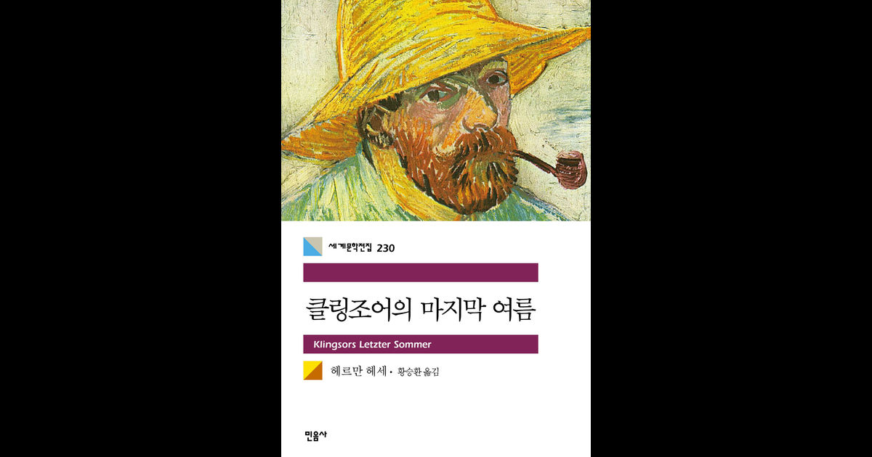

Slide 11
