Slide 2
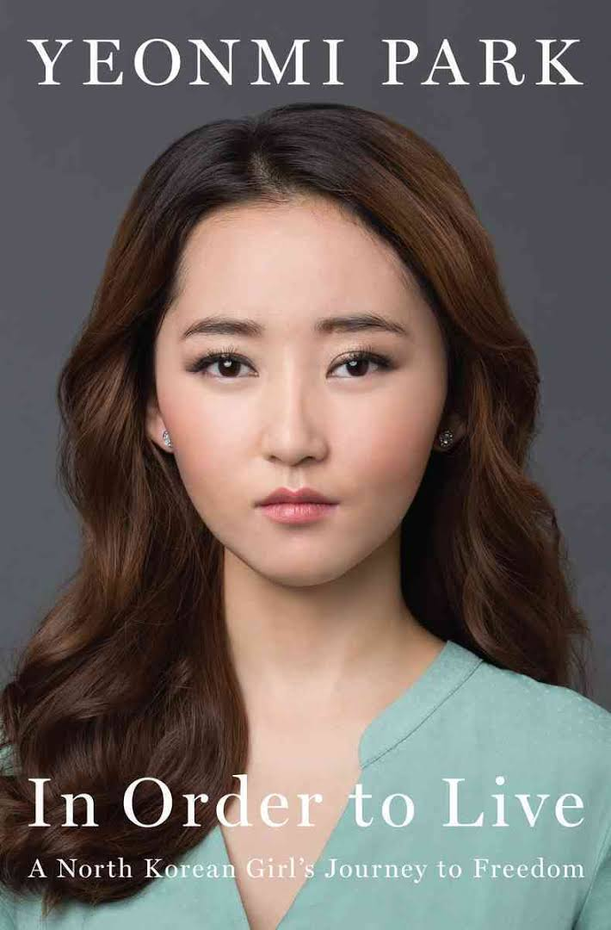

Slide 3
Yeonmi Park 박연미
North Korean defector and Human Rights Activist
Born in Hyesan, North Korea, 1993
In 2007 (at age of 13), crossed a Yalu river into China with her mother and finally sought refuge to South Korea in 2009
Her stories featured on media worldwide
Author of In Order to Live: A North Korean Girl’s Journey to Freedom, in 15 languages and 18 countries
In January 2016, she starts at The School of General Studies of Columbia University in NYC

