Slide 1
ATM S 358: Fundamentals of Atmospheric Chemistry
Lecture Topic: Inequity in air quality
An introduction to the chemical and physical processes determining the composition of the atmosphere and implications for climate, ecosystems, and human welfare. Nitrogen, oxygen, carbon, sulfur cycles. Chemical forcing of climate change. Stratospheric ozone. Oxidizing power of the atmosphere. Air pollution. Acid rain.
By the end of the quarter, students will have a basic knowledge of:
The chemical composition of the atmosphere
The sources and sinks of trace gases and aerosols in the atmosphere
The importance of chemicals in the atmosphere for climate, human health and ecosystem health
Air pollution, acid rain, and stratospheric ozone depletion
Notes:
Averaging Kernel
\mathbf{A} = \frac{\partial \hat{x}_i}{\partial x_j} = (\mathbf{B} - \mathbf{Q})\mathbf{B}^{-1}
Posterior solution
\mathbf{\hat{x}} = \mathbf{x_a} + \left(\mathbf{HB}\right)^T\left(\mathbf{HBH}^T + \mathbf{R}\right)^{-1}\left(\mathbf{y} -\mathbf{Hx_a}\right)

Slide 2
ATM S 358: Fundamentals of Atmospheric Chemistry
Lecture Topic: Inequity in air quality
Kerr, et al., PNAS (under review)
Notes:
Averaging Kernel
\mathbf{A} = \frac{\partial \hat{x}_i}{\partial x_j} = (\mathbf{B} - \mathbf{Q})\mathbf{B}^{-1}
Posterior solution
\mathbf{\hat{x}} = \mathbf{x_a} + \left(\mathbf{HB}\right)^T\left(\mathbf{HBH}^T + \mathbf{R}\right)^{-1}\left(\mathbf{y} -\mathbf{Hx_a}\right)

Slide 3
Learning objectives
The magnitude of the inequity in air quality
Non-white neighborhoods have worse AQ during the lockdown than white neighborhoods before lockdowns (even with a ~50% decrease in traffic!)
How to approach the scientific literature
The students have a term paper/presentation for the course where they need to cover a topic in atmospheric chemistry (e.g., aerosols and geoengineering, dust and snowball Earth, etc)
Notes:
Averaging Kernel
\mathbf{A} = \frac{\partial \hat{x}_i}{\partial x_j} = (\mathbf{B} - \mathbf{Q})\mathbf{B}^{-1}
Posterior solution
\mathbf{\hat{x}} = \mathbf{x_a} + \left(\mathbf{HB}\right)^T\left(\mathbf{HBH}^T + \mathbf{R}\right)^{-1}\left(\mathbf{y} -\mathbf{Hx_a}\right)

Slide 4
Why this paper?
It covers topics the students will have recently learned about (NO_{x} and air pollution)
It’s an example of something actual researchers are working on
It’s a nice example of scientists using a “natural experiment”
It highlights some of the complexity in air quality response
Non-white neighborhoods had the largest air quality improvement, but still saw worse AQ than white neighborhoods before the lockdown
Kerr, et al., PNAS (under review)
Notes:
Averaging Kernel
\mathbf{A} = \frac{\partial \hat{x}_i}{\partial x_j} = (\mathbf{B} - \mathbf{Q})\mathbf{B}^{-1}
Posterior solution
\mathbf{\hat{x}} = \mathbf{x_a} + \left(\mathbf{HB}\right)^T\left(\mathbf{HBH}^T + \mathbf{R}\right)^{-1}\left(\mathbf{y} -\mathbf{Hx_a}\right)

Slide 5
Tasks for the students
Each student will:
1) Read the paper (5 pages long)
2) Watch a short video from the author
3) Post 2 discussion questions the night before
Those questions will form the basis for discussion/breakout groups
Each group will be assigned 2 questions for ~15 min
Groups will report back on one question
We’ll then discuss a couple of the figures in more detail
Students will speak to one person about the topic after the class
Notes:
Averaging Kernel
\mathbf{A} = \frac{\partial \hat{x}_i}{\partial x_j} = (\mathbf{B} - \mathbf{Q})\mathbf{B}^{-1}
Posterior solution
\mathbf{\hat{x}} = \mathbf{x_a} + \left(\mathbf{HB}\right)^T\left(\mathbf{HBH}^T + \mathbf{R}\right)^{-1}\left(\mathbf{y} -\mathbf{Hx_a}\right)

Slide 6
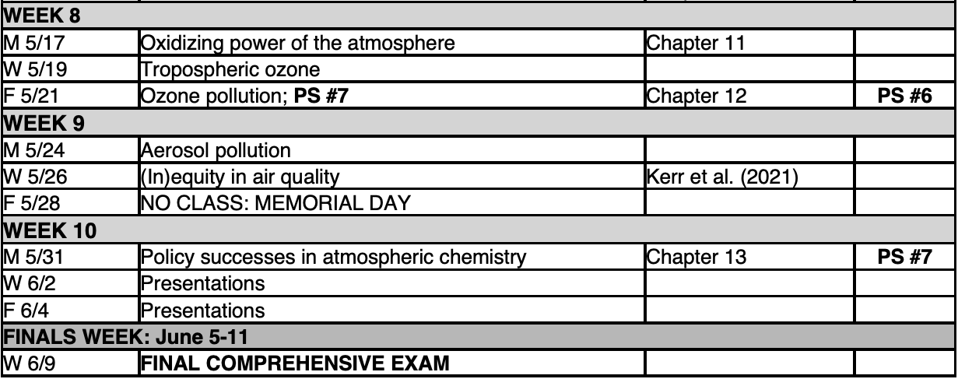
Climate justice in atmospheric chemistry
Big Idea:
Air Pollution
Climate Justice Issue:
There are stark disparities in air pollution based on race, ethnicity, etc
Civic Engagement:
Students will discuss the topic with someone (roommate?) after the lecture
Notes:
Averaging Kernel
\mathbf{A} = \frac{\partial \hat{x}_i}{\partial x_j} = (\mathbf{B} - \mathbf{Q})\mathbf{B}^{-1}
Posterior solution
\mathbf{\hat{x}} = \mathbf{x_a} + \left(\mathbf{HB}\right)^T\left(\mathbf{HBH}^T + \mathbf{R}\right)^{-1}\left(\mathbf{y} -\mathbf{Hx_a}\right)

